Slide 1



Master of Science in Computer Engineering
Rethinking Automotive Software Development: Exploring Software Defined Vehicle and its potential
Candidate
Lorenzo SCIARA
Supervisors
prof. Danilo Bazzanella
dott.sa Piera Limonet

Slide 2


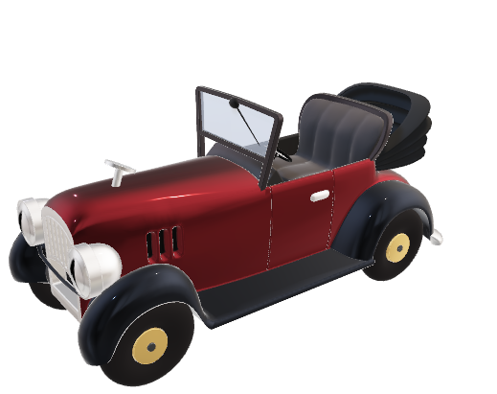
AUTOMOTIVE CONTEXT
AGENDA
MECHANICS
SOFTWARE

Slide 3
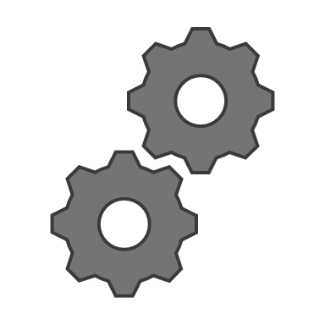

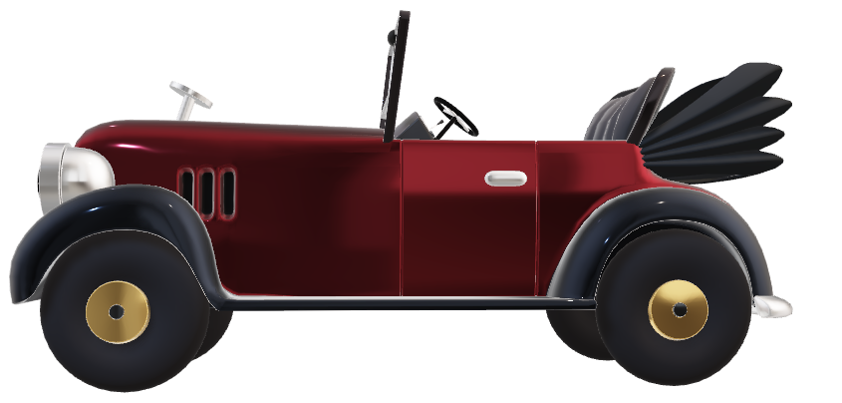
AUTOMOTIVE CONTEXT
In the past automotive industry software production was always considered secondary to the mechanical ones.
MECHANICS
SOFTWARE

Slide 4



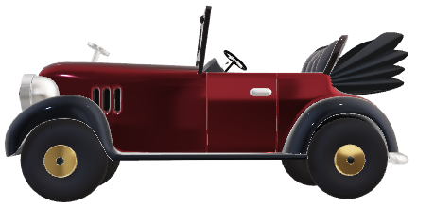
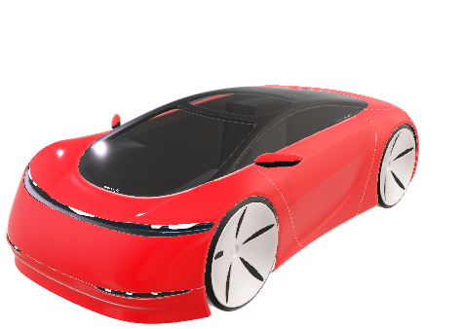
SOFTWARE DEFINED VEHICLE
AUTOMOTIVE CONTEXT
The focus on the mechanical parts of the vehicle resulted in software being very dependent on the hardware
HARDWARE
MECHANICS
SOFTWARE
SOFTWARE

Slide 5




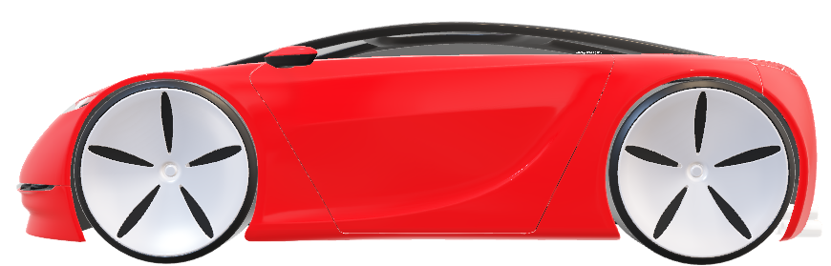
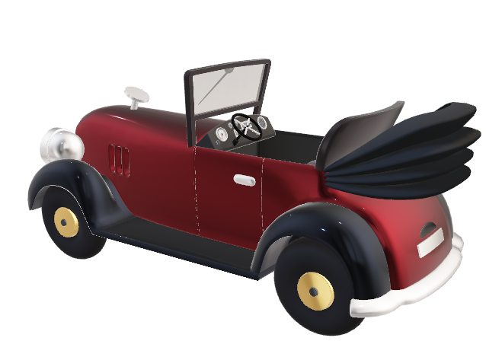
CLOUD
SOFTWARE DEFINED VEHICLE
Software Defined Vehicle enables software to become a fundamental element of vehicle design
SECURITY
EFFICIENCY
DURABILITY
SOFTWARE
MECHANICS
HARDWARE

Slide 6
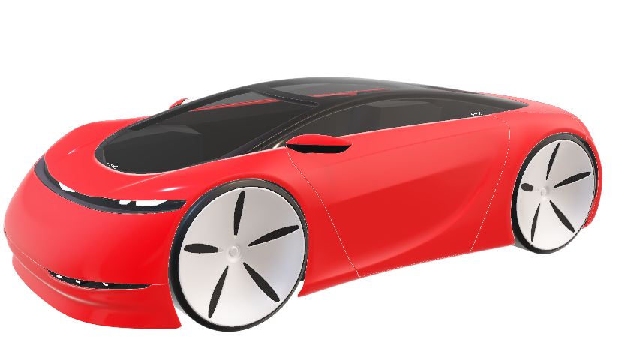
CLOUD
The vehicle is directly connected to the cloud
SOFTWARE
MECHANICS
HARDWARE

Slide 7
BENEFITS
CLOUD
SECURITY
EFFICIENCY
DURABILITY
The vehicle is directly connected to the cloud
Both for data analysis and has to receive Over The Air (OTA) updates

Slide 8
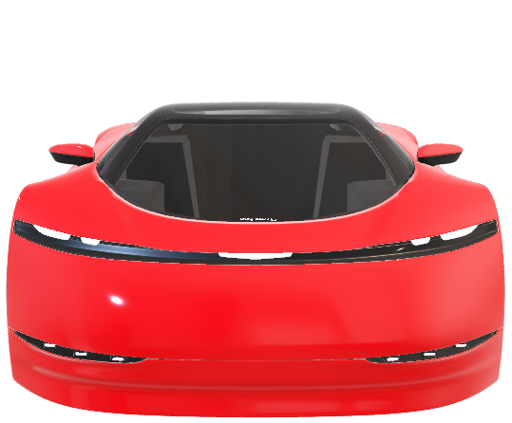
BENEFITS
SECURITY
EFFICIENCY
DURABILITY

Slide 9
BENEFITS
SECURITY
EFFICIENCY
DURABILITY
Vehicle vulnerabilities can be remotly fixed with OTA updates

Slide 10
BENEFITS
EFFICIENCY
SECURITY
DURABILITY
The software production is significantly increased thanks to the software independence

Slide 11
CONTRIBUTORS
BENEFITS
DURABILITY
SECURITY
EFFICIENCY
vehicle lifecycle is increased through constant updates and the addition of new features

Slide 12

CONTRIBUTORS
BENEFITS
TCU SIMULATOR
CLOUD INFRASTRUCTURE
DATA VIEWER
SECURITY
EFFICIENCY
DURABILITY

Slide 13
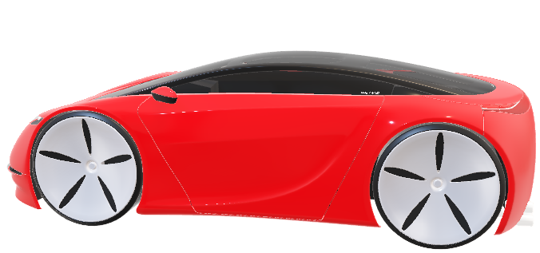
CONTRIBUTORS
SECURITY
EFFICIENCY
DURABILITY
TCU SIMULATOR
CLOUD INFRASTRUCTURE
DATA VIEWER

Slide 14
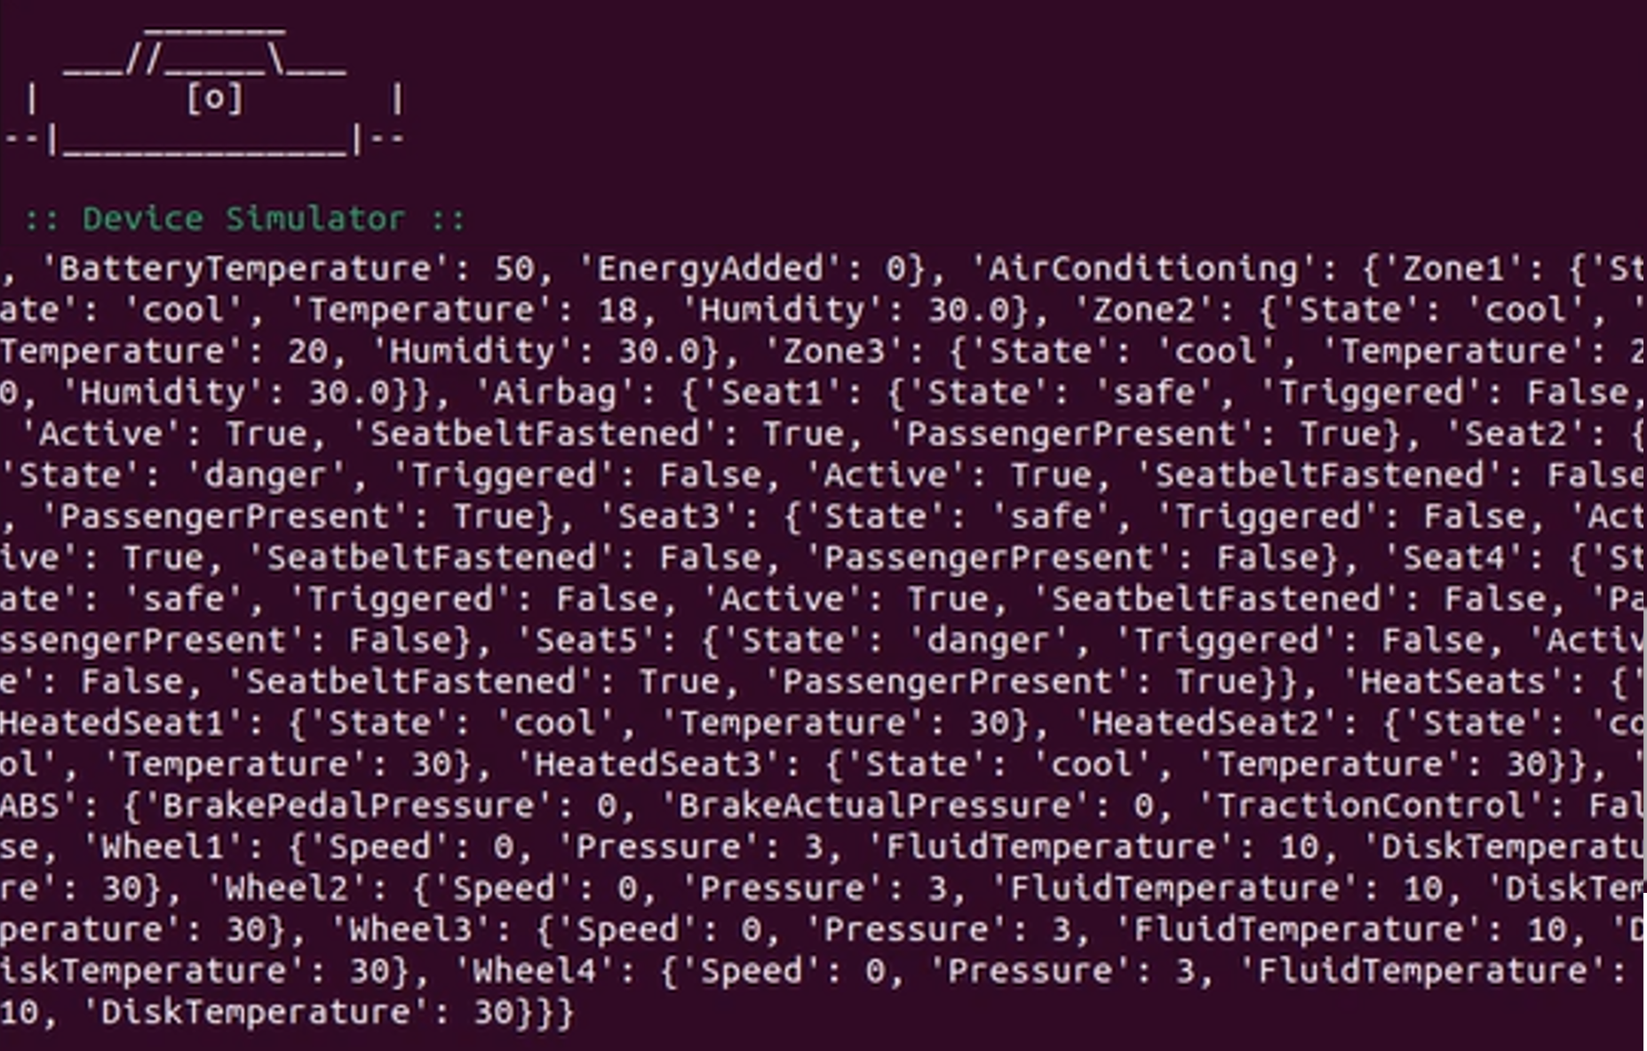
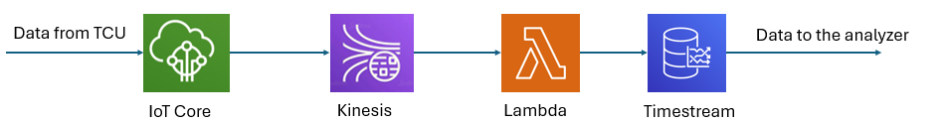
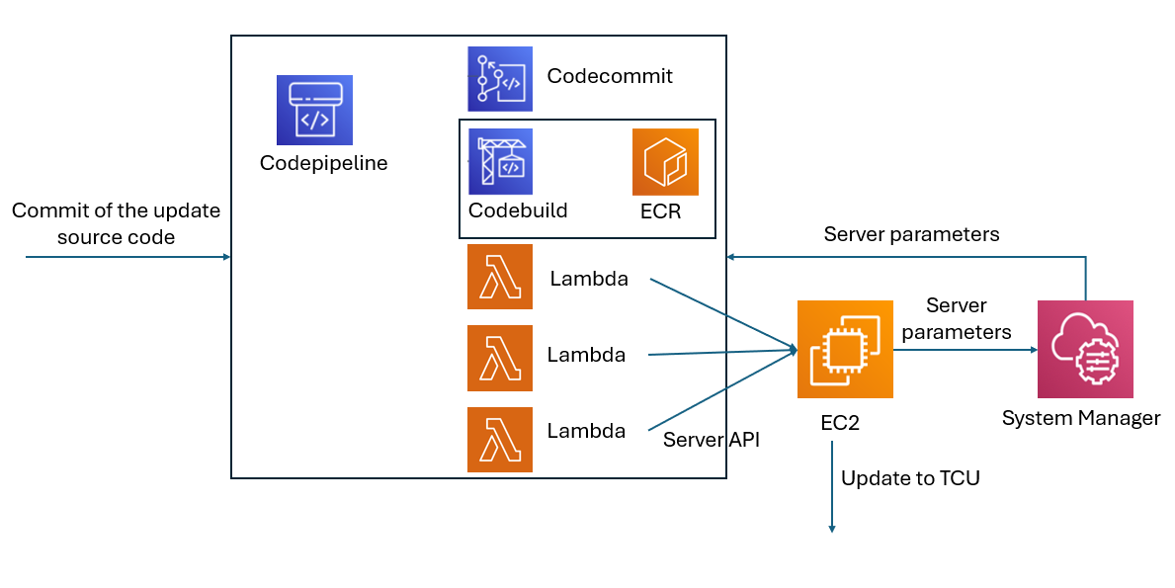
CONTRIBUTORS
TCU SIMULATOR
It is a system that can collect and transmit data from simulated subsystems and integrate updates from external sources
CLOUD INFRASTRUCTURE
DATA VIEWER
With the use of AWS services two different cloud infrastructure can be built:
The first one for the data collection from the TCU simulator.
The second one for the software updates management and deployment with also the use of Hawkbit server.

Slide 15
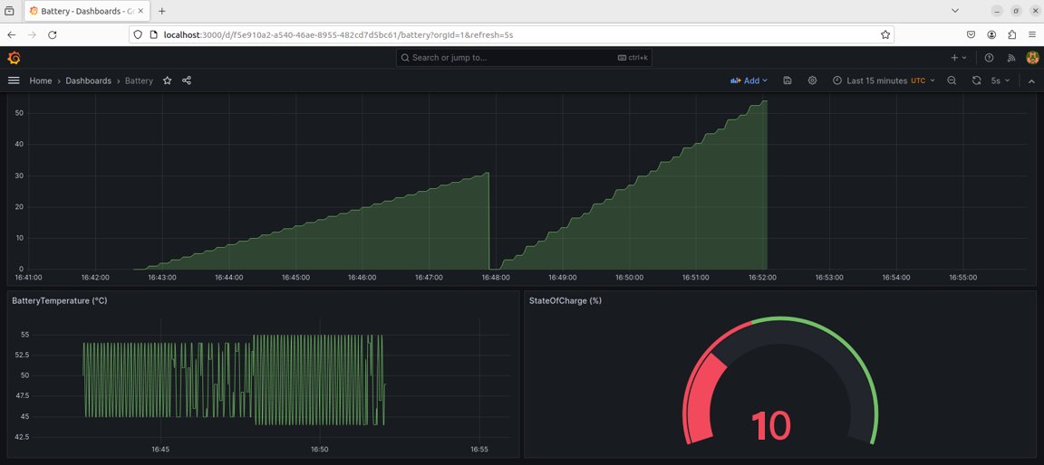
CONTRIBUTORS
TCU SIMULATOR
It is a system that can collect and transmit data from simulated subsystems and integrate updates from external sources
CLOUD INFRASTRUCTURE
DATA VIEWER
The data are shown with the use of a Grafana server in an easy to view and user-friendly dashboards
With the use of AWS services two different cloud infrastructure can be built:
The first one for the data collection from the TCU simulator.
The second one for the software updates management and deployment with also the use of Hawkbit server.

Slide 16
CONTRIBUTORS
TCU SIMULATOR
CLOUD INFRASTRUCTURE
DATA VIEWER
The data are shown with the use of a Grafana server in an easy to view and user-friendly dashboards
With the use of AWS services two different cloud infrastructure can be built:
The first one for the data collection from the TCU simulator.
The second one for the software updates management and deployment with also the use of Hawkbit server.

Slide 17
VALIDATION
CONTRIBUTORS
TCU SIMULATOR
CLOUD INFRASTRUCTURE
DATA VIEWER

Slide 18
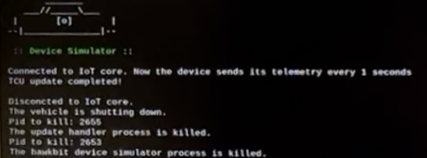
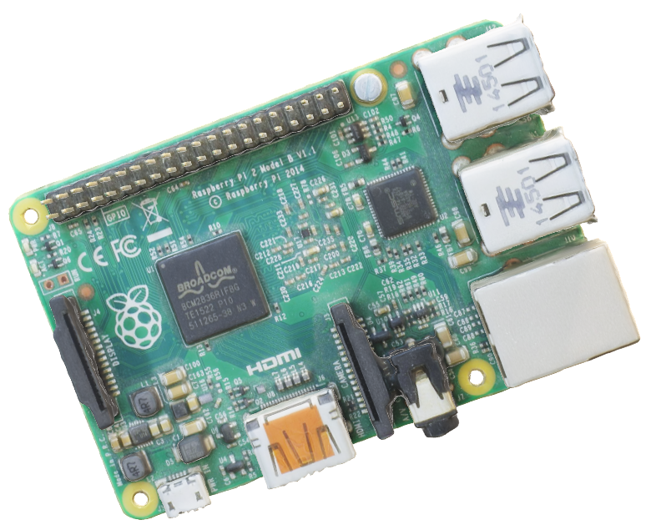
VALIDATION
The entire Proof of Concept is tested on a system that can simulate in the most true way a vehicle TCU. The RaspberryPi is selected for this reason.

Slide 19
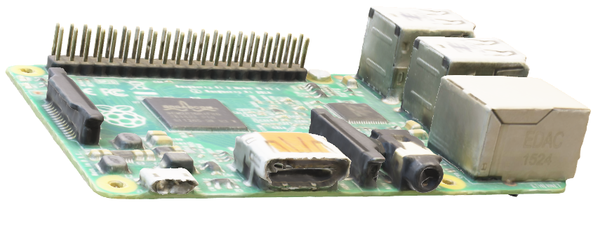
FUTURE WORKS
VALIDATION

Slide 20
FUTURE WORKS
Interaction with a real car
More in depth study of third party tools used
More in depth study of third party tools used

Slide 21
FUTURE WORKS
Thanks for the attention
Any questions?

